Slide 1

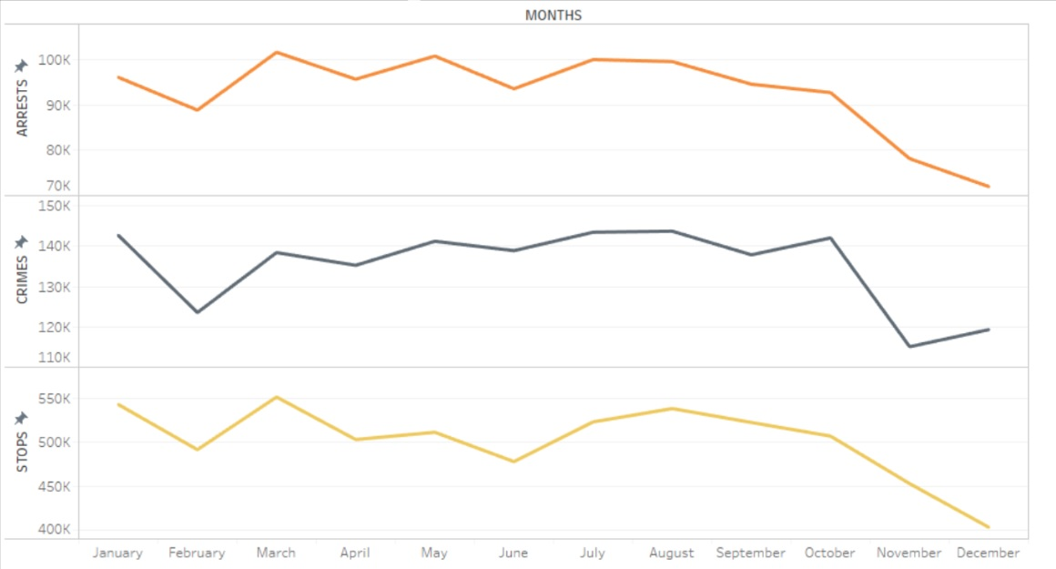
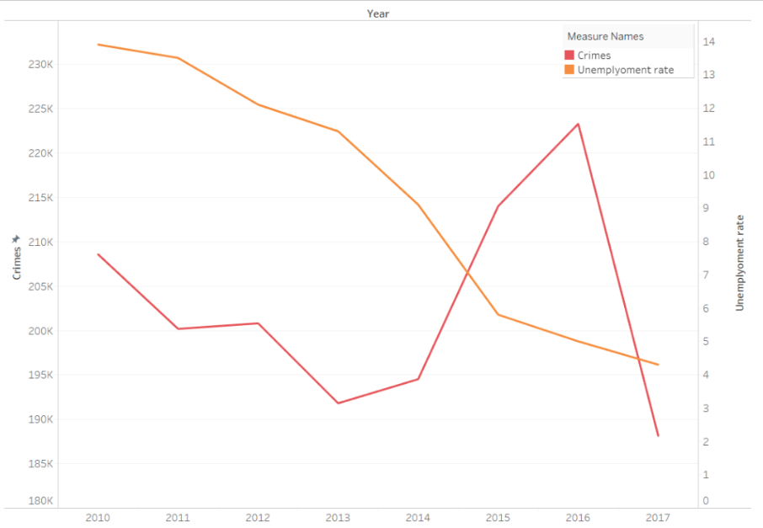
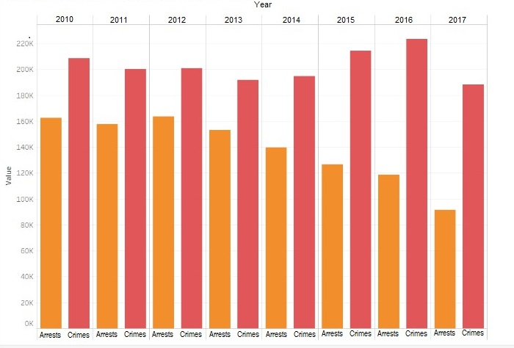
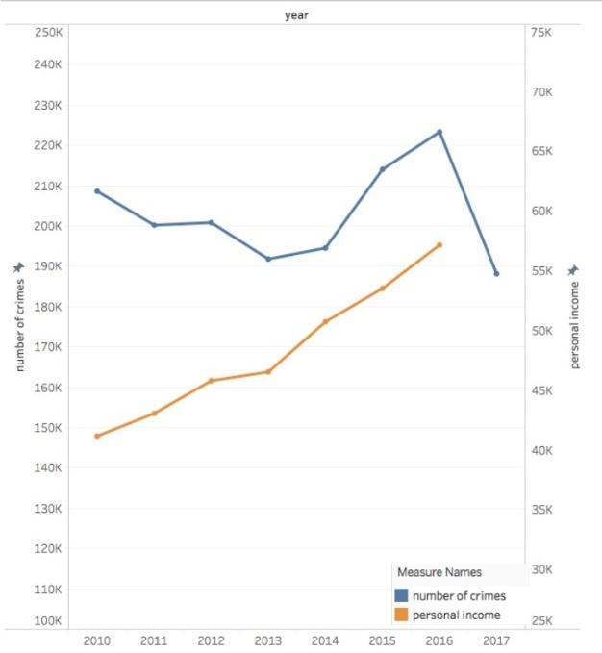
Hadoop Big Data Analysis of Los Angeles Police Department (LAPD) Activity with Demographic and Socio-economic Implications
Ruchita Shinde, Tejas Agara Chandrakumar, Nikita Shendkar, Gregory Mamoyac | Dr. Jongwook Woo | California State University, Los Angeles
Problem / Question
dataset and across multiple datasets and is collected from government open source at DataLA and ControlPanel LA.
The bulk of the data is derived from LAPD activity, which is split into three datasets. The three datasets are vehicle and pedestrian stops, crimes, and arrests information originally collected for purposes of police reporting. The remainder of the data is on LA’s demographic, socio-economic, and census history.
Figure 4. Total Reports of Stops, Crimes, and Arrests Per Month from 2010-2017
What are the economic and demographic implications of the city of LA to LAPD activity?
How do the volumes of stop, crimes and arrests compare over time?
Hypothesis
Demographic and economic statistics like the unemployment rate and personal income per capita will adversely affect LAPD activity statistics.
The volume of arrests can be estimated over time through month by month and annual anlysis.
Data / Observations
Conclusion
Analysis into "LAPD Activity” provides insight into significant periods of times and areas of interest where police can focus valuable resources including budgeting, manpower, and energy.
Analysis into "Demographic and Socio-Economic Implications" provides the examination for political and socioeconomic initiatives that may be designed by policymakers and leaders in the community.
This data project continues the key themes of public safety, open transparency, accountability, civic engagement, public benefit from government open source, integrity of services, and public resilience. Furthermore is opens the study of public safety activity that can be applied to other police databases in order to address at-risk groups and communities.
Project Overview
Figure 1. Comparison of Unemployment Rate to Crimes for Years 2010-2017
Big Data has rapidly evolved in many fields including the police department.
The Hadoop Big Data analysis of LAPD data accomplishes unique insights into police activity and city awareness which includes public safety, integrity of services, and public resilience.
The LAPD Activity under consideration is of Crimes , Arrests and Stops reported from the year 2010- 2017.
Significant instances of police activity to geo- spatial and Temporal data .
Investigating the correlation of police activity to demographic and economic data in order to raise city awareness for larger issues affecting the community.
Figure 2. Comparison of Total Reports of Crimes and Total Reports of Arrests by Years 2010-2017
Works Cited
[1] “Los Angeles - Open Data Portal,” City of Los Angeles. [Online]. Available: https://data.lacity.org/browse. [Accessed: 06-Nov-2017].
[2] “Los Angeles | Open Data | Control Panel LA,” Socrata. [Online]. Available: https://controllerdata.lacity.org/data. [Accessed: 06-Nov-2017].
[3] “Federal Reserve Economic Data | FRED | St. Louis Fed,” FRED. [Online]. Available: https://fred.stlouisfed.org/. [Accessed: 06-Nov-2017].
Procedure
Figure 3. Comparison of Personal Income Per Capita to Crimes for Years 2010-2017
This is done with Apache Hadoop IOP 4.2 and Pig version 0.15.0 on a 3- 1 data node- management node configuration. Visualization is done using Tableau 10.4.
Analysis is made along field relations within a single

